Slide 1




Slide 2
Building a Review-Based QA System
Notes:
Hello and welcome, in this video we will start to dive into the components of the internal structure of transformers.

Slide 3
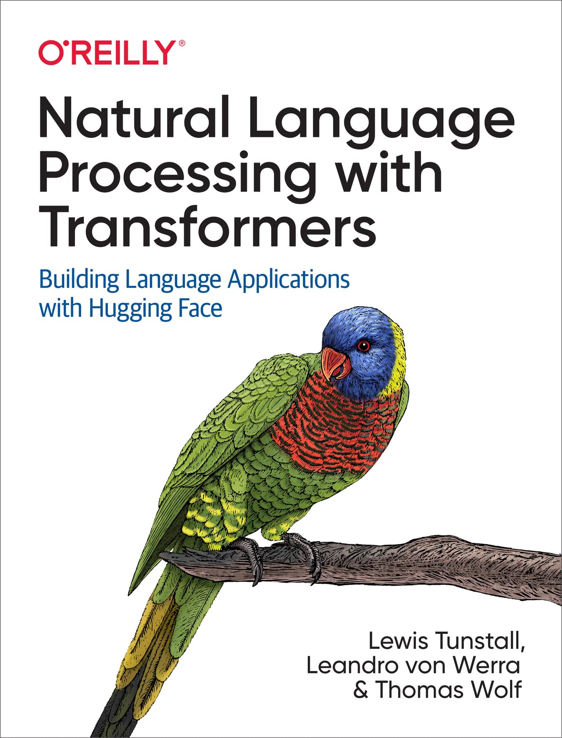


Introduction
Problem: find a relevant review.
Solution:
The community QA platforms provided by websites like Amazon.
Get an immediate answer using transformers.
Can I use this camera at night?
Does this guitar come with a strap?

Slide 4
The Dataset
The SubjQA2 dataset → more than 10,000 customer reviews in English about products and services in six domains: (Trip‐Advisor, Restaurants, Movies, Books, Electronics, Grocery)
Each review is associated with a question that can be answered using one or more sentences from the review.
Note: unanswerable questions → produce more robust models.

Slide 5
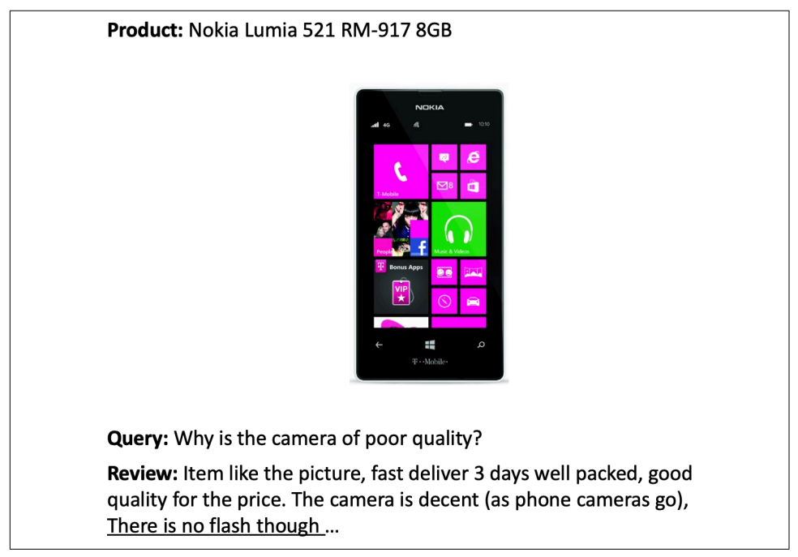
The Dataset Example
SubjQA dataset → the questions and answers are subjective
They depend on the personal experience of the users.
The task is potentially more difficult than finding answers to factual questions.
These features make SubjQA a realistic dataset to benchmark our review-based QA models on.

Slide 6
Loading SubjQA dataset
Download the dataset from the Hugging Face Hub :
Focus on building a QA system for the Electronics domain:
SubjQA stores the answers to each question as a nested dictionary.
from datasets import get_dataset_config_names
domains = get_dataset_config_names("subjqa")
domains
['books', 'electronics', 'grocery', 'movies', 'restaurants', 'tripadvisor']
from datasets import load_dataset
subjqa = load_dataset("subjqa" , name="electronics")
print(subjqa["train" ]["answers" ][1])
{ 'text' : ['Bass is weak as expected', 'Bass is weak as expected, even with EQ adjusted up'], 'answer_start' : [1302, 1302], 'answer_subj_level' : [1, 1], 'ans_subj_score' : [0.5083333253860474, 0.5083333253860474], 'is_ans_subjective' : [True, True]}

Slide 7
Data exploration
Flatten the nested columns and convert each split to a Pandas DataFrame:
Notice: that the dataset is relatively small, with only 1,908 examples in total.
import pandas as pd
dfs = {split: dset.to_pandas() for split, dset in subjqa.flatten(). items()}
for split, df in dfs.items():
print(f"Number of questions in {split}: {df['id'].nunique()}" )
Number of questions in train: 1295
Number of questions in test: 358
Number of questions in validation: 255

Slide 8
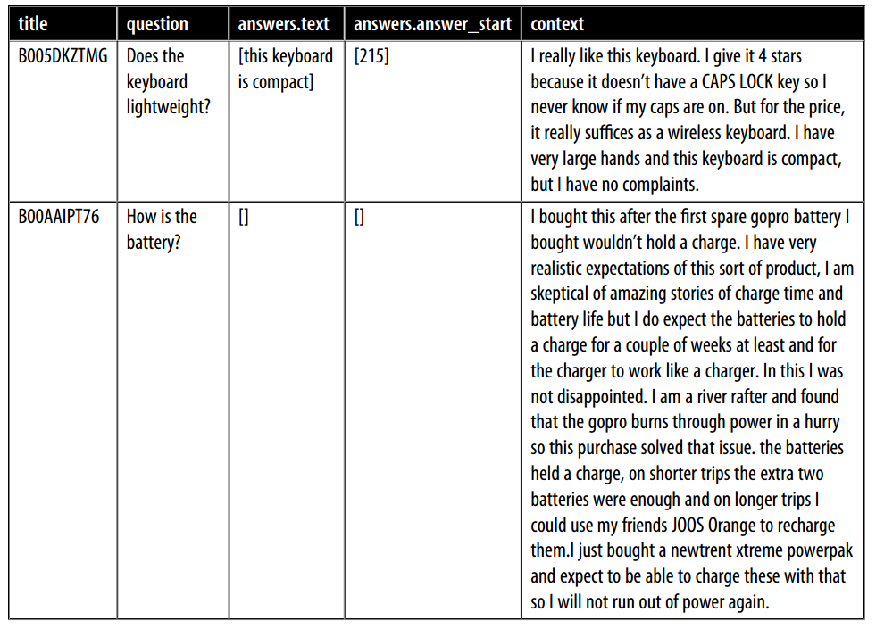
Sample of Data
Columns in the SubjQA dataset:
qa_cols = ["title", "question", "answers.text", "answers.answer_start", "context" ]

Slide 9
Sample of Data
Columns in the SubjQA dataset:
qa_cols = ["title", "question", "answers.text", "answers.answer_start", "context" ]

Slide 10
Sample of Data
Columns in the SubjQA dataset:
qa_cols = ["title", "question", "answers.text", "answers.answer_start", "context" ]

Slide 11
Sample of Data
Columns in the SubjQA dataset:
qa_cols = ["title", "question", "answers.text", "answers.answer_start", "context" ]

Slide 12
Sample of Data
Columns in the SubjQA dataset:
qa_cols = ["title", "question", "answers.text", "answers.answer_start", "context" ]
sample_df = dfs["train" ][qa_cols].sample(2, random_state=7)

Slide 13
Extracting Answers from Text
The Goal→ QA system identify a potential answer as a span of text in a customer review.
For example:
Question: “Is it waterproof?”
Passage: “This watch is waterproof at 30m depth”.
Output: “waterproof at 30m”.
How span text works:
Frame the supervised learning problem.
Tokenize and encode text for QA tasks.
Deal with long passages that exceed a model’s maximum context size.

Slide 14
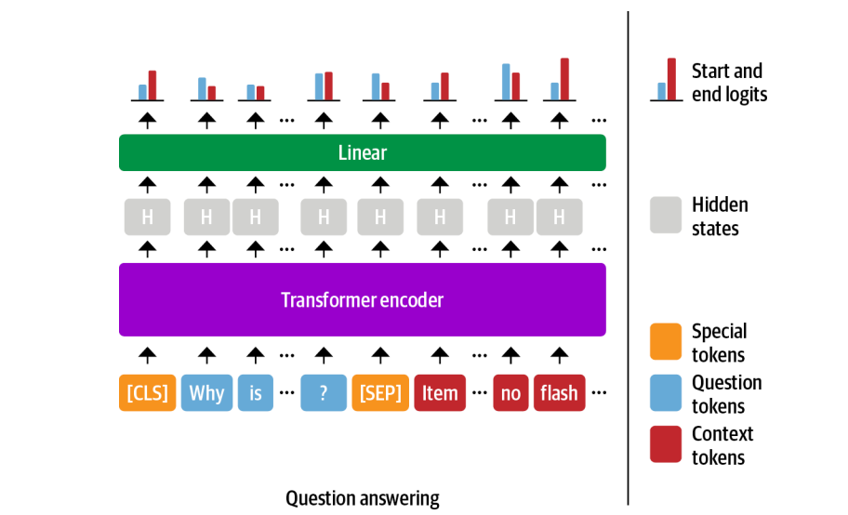
Span classification
Span classification task: extract answers from text is by framing the problem.
The start and end tokens of an answer span act as the labels that a model needs to predict.
Our training set is relatively small, with only 1,295 examples.
Good strategy → start with a language model that has already been fine-tuned on a large-scale QA dataset like SQuAD.
These models have strong reading comprehension capabilities.

Slide 15
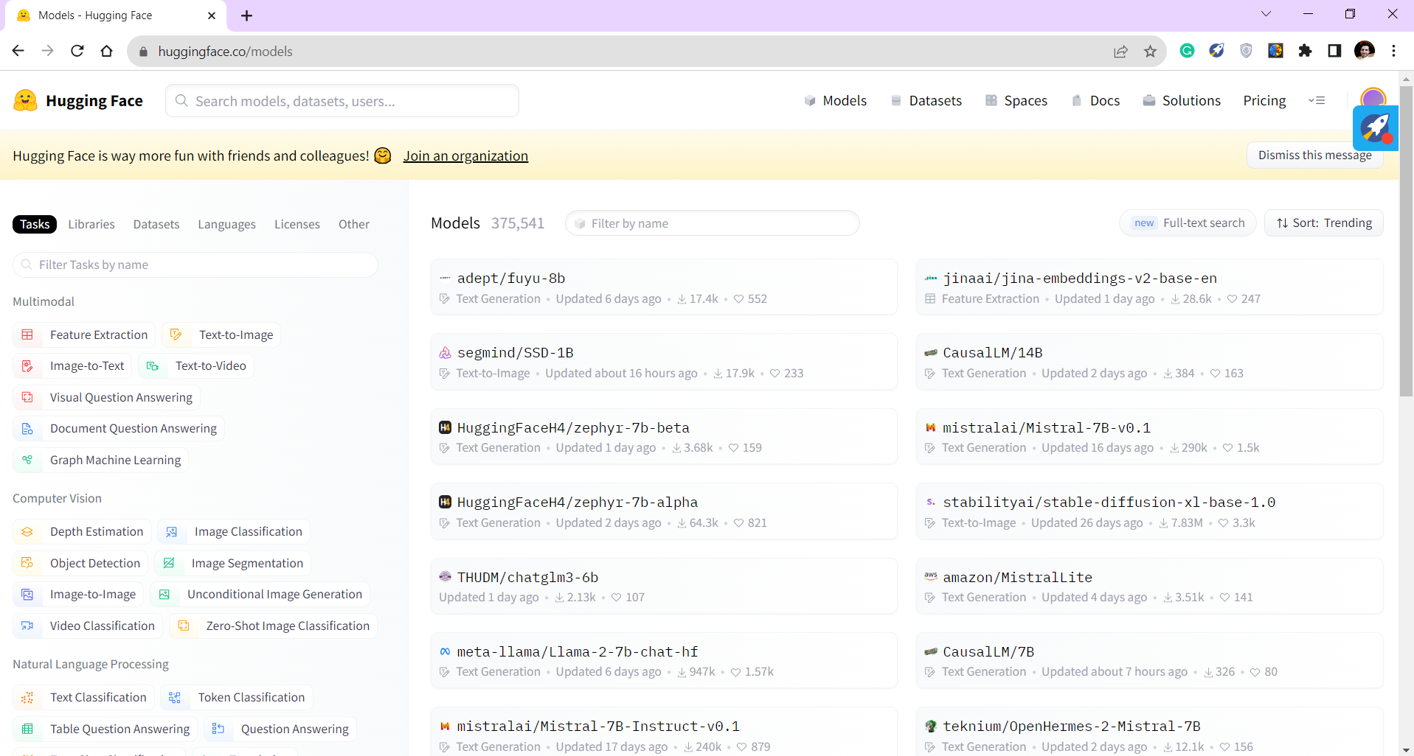
Fine-tunning Extractive QA

Slide 16
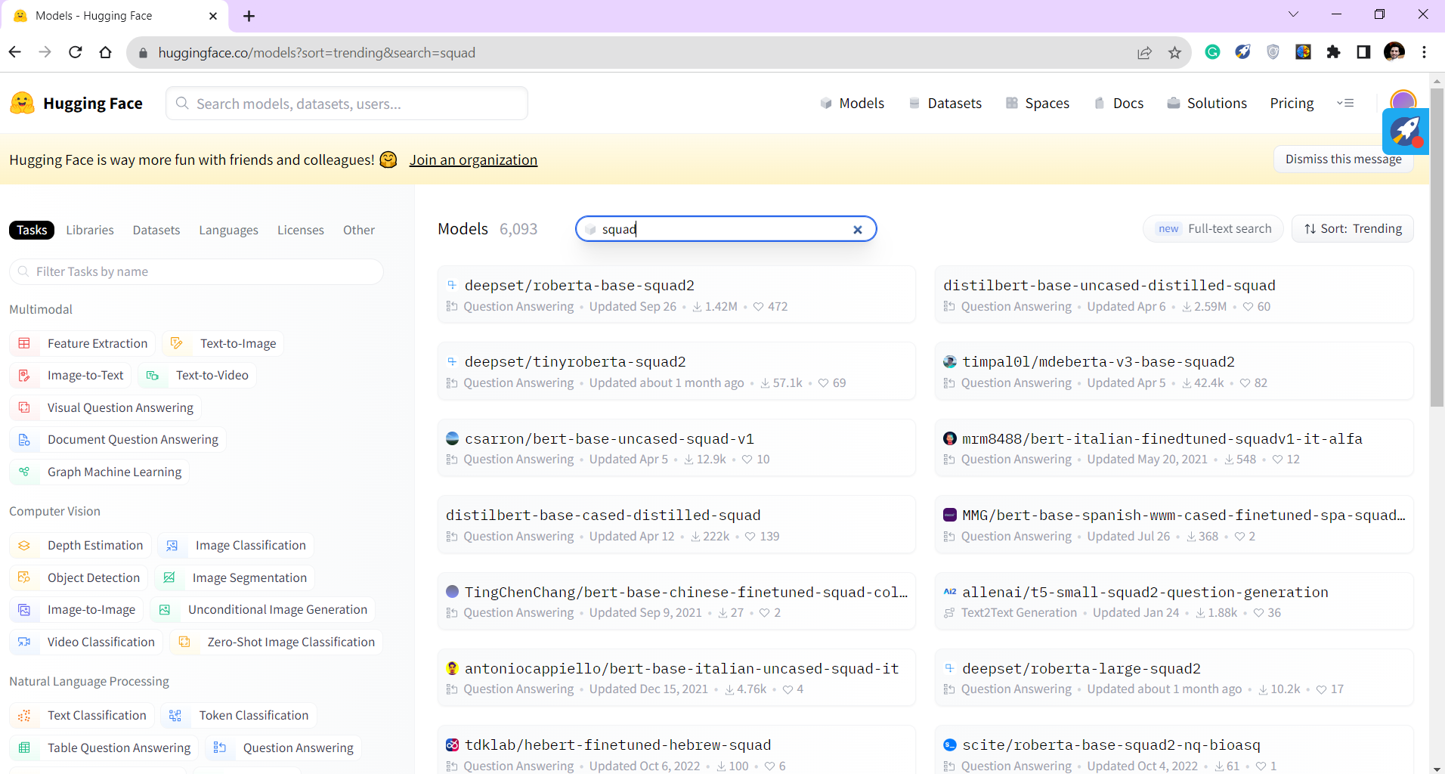
Fine-tunning Extractive QA

Slide 17
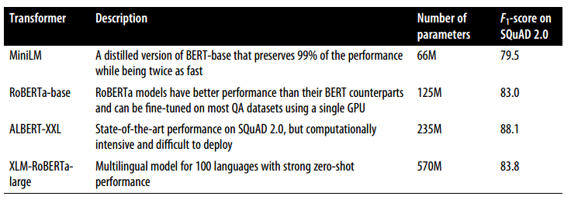
Fine-tunning Extractive QA
The answer depends on various factors:
The corpus is mono- or multilingual.
The constraints of running the model in a production environment.

Slide 18
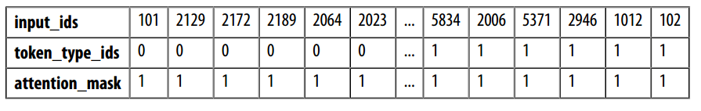
Tokenizing text for QA
Encode text using tokenizer:
Note: In extractive QA tasks, the inputs are provided as (question, context) pairs
input_ids: represent a unique numerical identifier for each token.
attention_mask: allows the model to ignore the padded parts of the input.
token_type_ids: tensor indicates which part of the inputs corresponds to the question and context.
0 → a question token
1 → a context token
from transformers import AutoTokenizer
model_ckpt = "deepset/minilm-uncased-squad2"
tokenizer = AutoTokenizer. from_pretrained(model_ckpt)
question = "How much music can this hold?"
context = "An MP3 is about 1 MB/minute, so about 6000 hours depending on file size."
inputs = tokenizer(question, context, return_tensors="pt" )

Slide 19
Tokenizing text for QA
To understand how the tokenizer formats the inputs for QA tasks:
Decode the input_ids tensor:
print(tokenizer. decode(inputs["input_ids" ][0]))
[CLS] how much music can this hold? [SEP] an mp3 is about 1 mb / minute, so about 6000 hours depending on file size. [SEP]
[CLS] question tokens [SEP] context tokens [SEP]

Slide 20

Tokenizing text for QA
Instantiate the model with a QA head and run the inputs through the forward pass:
QA Head → linear layer
This means that we treat QA as a form of token classification.
import torch
from transformers import AutoModelForQuestionAnswering
model = AutoModelForQuestionAnswering. from_pretrained(model_ckpt)
with torch. no_grad():
outputs = model(**inputs)
print(outputs)
QuestionAnsweringModelOutput(loss=None, start_logits=tensor([[-0.9862, -4.7750, -5.4025, -5.2378, -5.2863, -5.5117, -4.9819, -6.1880, -0.9862, 0.2596, -0.2144, -1.7136, 3.7806, 4.8561, -1.0546, -3.9097, -1.7374, -4.5944, -1.4278, 3.9949, 5.0390, - 0.2018, -3.0193, -4.8549, -2.3107, -3.5110, -3.5713, -0.9862]]), end_logits=tensor([[-0.9623, -5.4733, -5.0326, -5.1639, -5.4278, -5.5151, -5.1749, -4.6233, -0.9623, -3.7855, -0.8715, -3.7745, -3.0161, -1.1780, 0.1758, -2.7365, 4.8934, 0.3046, -3.1761, -3.2762, 0.8937, 5.6606, -0.3623, -4.9554, -3.2531, -0.0914, 1.6211, -0.9623]]), hidden_states=None, attentions=None )

Slide 21
Tokenizing text for QA
Convert the outputs into an answer span:
Compare the shapes of these logits to the input IDs:
start_logits = outputs.start_logits
end_logits = outputs.end_logits
print(f"Input IDs shape: {inputs.input_ids.size()}")
print(f"Start logits shape: {start_logits.size()}")
print(f"End logits shape: {end_logits.size()}")
Input IDs shape: torch.Size([1, 28]) Start logits shape: torch.Size([1, 28]) End logits shape: torch.Size([1, 28])

Slide 22
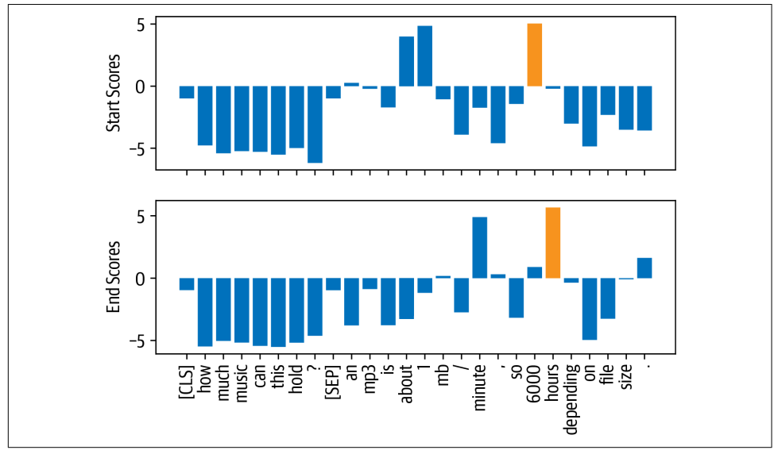
Tokenizing text for QA
There are two logits (a start and end) associated with each input token.
larger and positive logits correspond to more likely candidates for the start and end tokens.
In this example:

Slide 23
Tokenizing text for QA
Get the final answer:
import torch
start_idx = torch. argmax(start_logits)
end_idx = torch. argmax(end_logits) + 1
answer_span = inputs["input_ids" ][0][start_idx: end_idx]
answer = tokenizer. decode(answer_span)
print(f"Question: {question}" )
print(f"Answer: {answer}" )
Question: How much music can this hold? Answer: 6000 hours

Slide 24
Pipeline Function
Instantiate the pipeline by passing our tokenizer and fine-tuned model :
If have questions for which no answer is possible.
The model will assign a high start and end score to the [CLS].
from transformers import pipeline
pipe = pipeline("question-answering" , model=model, tokenizer=tokenizer)
pipe(question=question, context=context, topk=3)
[{'score': 0.26516005396842957,'start': 38,'end': 48,'answer': '6000 hours'}, {'score': 0.2208300083875656,'start': 16,'end': 48,'answer': '1 MB/minute, so about 6000 hours'}, {'score': 0.10253632068634033,'start': 16,'end': 27,'answer': '1 MB/minute'}]
pipe(question="Why is there no data?" , context=context, handle_impossible_answer=True)
{'score': 0.9068416357040405, 'start': 0, 'end': 0, 'answer': ''}

Slide 25

What if the context often contains more tokens than the maximum sequence length of the model?

Slide 26
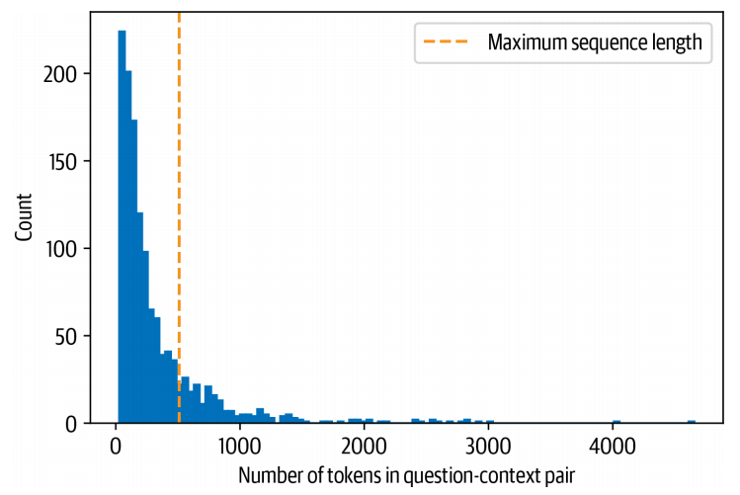
Dealing with long passages
For example:
The SubjQA training set contains question-context pairs that won’t fit within MiniLM’s context size of 512 tokens.
For text classification:
Truncating long texts under the assumption that enough information was contained in the embedding of the [CLS] token to generate accurate predictions.
Item like the picture, fast deliver 3 days well packed, good quality for the price. The camera is decent (as phone cameras go). There is no flash though...

Slide 27
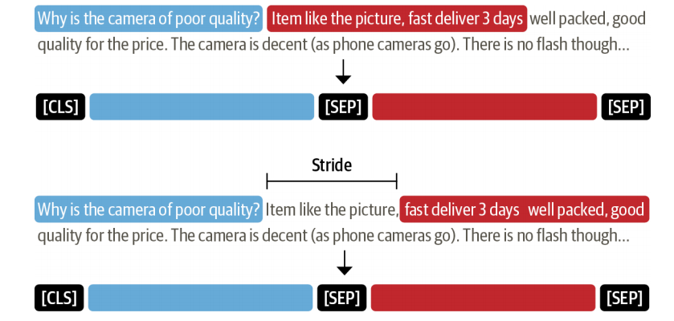
Dealing with long passages
Problem: the answer to a question could lie near the end of the context and thus would be removed by truncation.
Solution: apply a sliding window across the inputs, where each window contains a passage of tokens that fit in the model’s context.

Slide 28
Dealing with long passages
set in the tokenizer to enable the sliding window.
The size of the sliding window is controlled by the max_length argument
The size of the stride is controlled by stride.
Example to illustrate how this works:
return_overflowing_tokens=True
example = dfs["train" ] . iloc[0][["question" , "context" ]]
tokenized_example = tokenizer( example["question" ],
example["context" ],
return_overflowing_tokens=True,
max_length=100,
stride=25)

Slide 29
Dealing with long passages
Check the number of tokens we have in each window:
Two windows overlap by decoding the inputs:
for idx, window in enumerate(tokenized_example["input_ids" ]):
print(f"Window #{idx} has {len(window)} tokens" )
for window in tokenized_example["input_ids" ]:
print(f"{tokenizer.decode(window)} \n" )
[CLS] how is the bass? [SEP] i have had koss headphones in the past, pro 4aa and qz - 99. the koss portapro is portable and has great bass response. the work great with my android phone and can be " rolled up " to be carried in my motorcycle jacket or computer bag without getting crunched. they are very light and don't feel heavy or bear down on your ears even after listening to music with them on all day. the sound is [SEP]
[CLS] how is the bass? [SEP] and don't feel heavy or bear down on your ears even after listening to music with them on all day. the sound is night and day better than any ear - bud could be and are almost as good as the pro 4aa. they are " open air " headphones so you cannot match the bass to the sealed types, but it comes close. for $ 32, you cannot go wrong. [SEP]

Slide 30
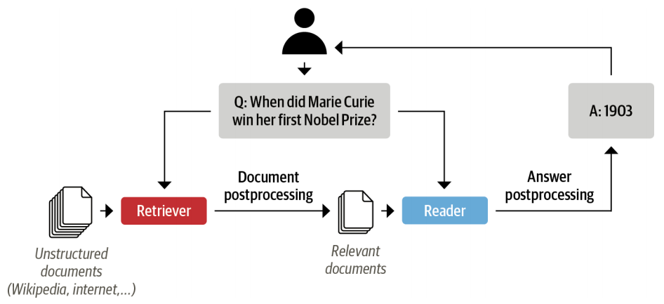
Summary
We learn:
How can QA models extract answers from the text?
Using a pre-trained QA model and passing the question along with the context.
Problem:
system’s users will only provide a question about a product.
Solution:
concatenate all the reviews of a given product together and feed them to the model as a single, long context.
The drawback of this approach:
the context can become extremely long and thereby introduce an unacceptable latency for our users’ queries.
To handle this, modern QA systems are typically based on the retriever-reader architecture.
SubjQA dataset
the Electronics domain.

Slide 31


